Slide 1
Managing Data
Università di Modena e Reggio Emilia
Prof. Nicola Bicocchi (nicola.bicocchi@unimore.it)

Slide 2
Storing Data
In this module we will explore the various tools available to save the data of our application. We have several options:
SharePreferences: store data in key value pairs
SQlite: store structured private app data
ContentProvider: store structured or semi structured data with user configurable data access
File Storage: store raw files on the phone memory SD card
Cloud Storage: use third part or custom-made external data storage APIs
SQlite
Shared Preferences
Content
Provider
Data
Storage
File storage
Cloud Storage

Slide 3
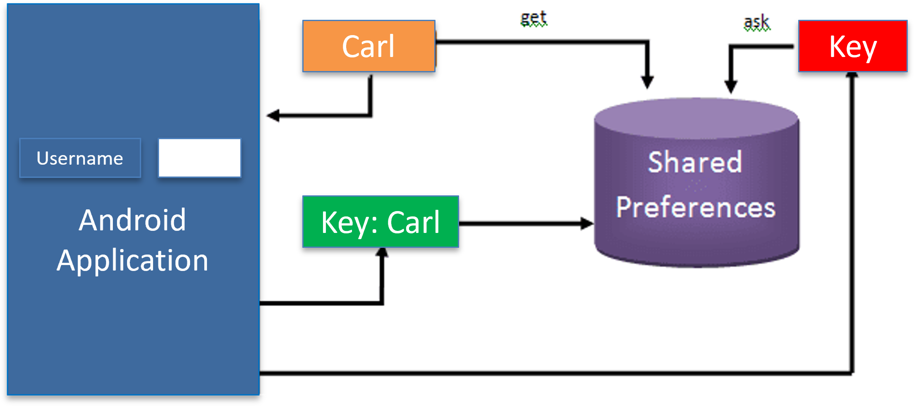
Shared Preferences
Easier mechanism to store data in Android without creating files or API to access it. terms are a key value pair; the aim is stored the value and retrieve with appropriate key.
Simply we have an XML file created automatically in directory Device:
data/data/<package-name>/shared-prefs where we store and retrieve data.
SharedPreferences only allow to save primitive data types such as boolean, float, long, int and string.
Are useful for:
check if user is using your app
check if our app was updated by storing time and date inside SharedPreferences
remember user credential
remember user settings
location caching: remember last location of user inside the app

Slide 4
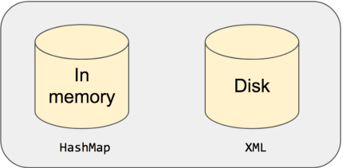
Internal Structure
Shared preferences internally has an in-memory storage on top of disk storage. Every operation goes through in-memory storage first and then to the disk if necessary.In-memory storage is basically a HashMap which allows O(1) runtime complexity for all operations and Disk storage is an xml file.
<?xml version='1.0' encoding='utf-8' standalone='yes' ?> _{<map>} <string name="KEY">value</string> _{</map>}
value map = HashMap<String, Any>()

Slide 5
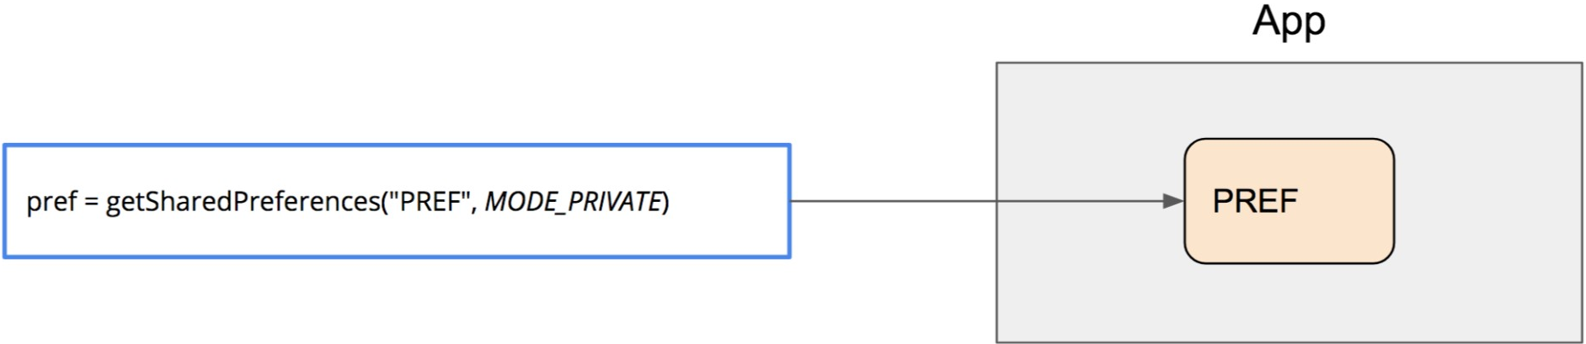
Accessing to data
If we have only one preference file, we can access it with getPreferences(int mode), but if we have several of them, we must use getSharedPreferences(String name, int mode).
Type of mode:
MODE_PRIVATE: only our app can access the file
MODE_WORD_READABLE: All apps can read the file (deprecated)
MODE_WORD_WRITABLE: All apps can write on the file (deprecated)
MODE_MULTI_PROCESS: Multiple processes can modify the same shared preference file.

Slide 6
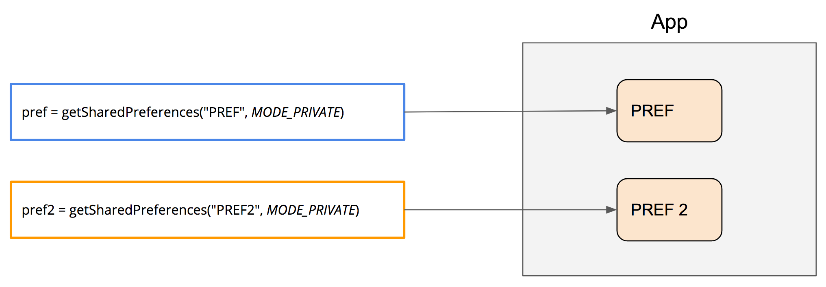
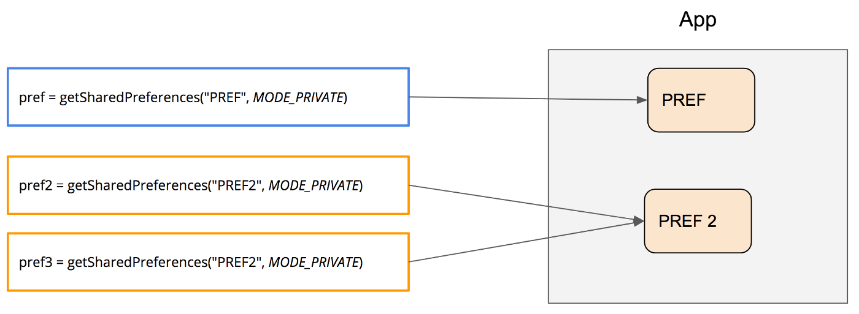
Accessing to data
Each shared preferences will have its own instance based on the preference name.
No matter in which context (Activity, fragment, application) it’s called, it will always return the same instance for the same name. This guarantees that you will always see the latest changes.

Slide 7
Save data
After obtaining a SharePreference reference with the appropriate parameters, to save the data we need to have a reference to the SharePreferences editor that allows us to edit the file.
SharedPreferences.Editor editor = sharedPreferences.edit();
At this point we can write to the file one of the possible types
editor.putString("username", “David”);
However, only writing is not enough to make the changes effective. The most common mistake is forgetting to make the changes effective; we have two methods available

Slide 8
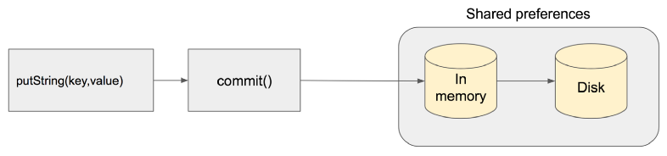
Save data with .commit()
Saves the data to in-memory storage first and then synchronously writes it to disk. Since IO operation is involved, main thread is blocked until the data is written to the disk. This is an expensive operation.
Since the disk write operation is synchronous, success status is returned as a boolean. Therefore, you can verify that whether the operation is successful or not by checking the return value.
val result = pref.edit().putString(key, "value").commit()

Slide 9
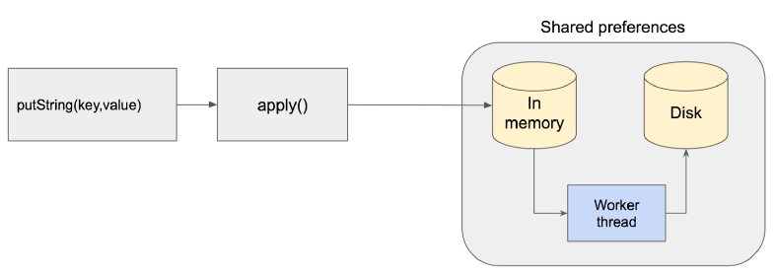
Save data with .apply()
Saves the data to in-memory storage first and then asynchronously writes it to disk. Main thread is not blocked and waiting for the disk operation anymore. Any read (get) after apply will return the latest saved value because of get operations are done through in-memory storage.
pref.edit().putString(key, "value").apply()
Since the disk write operation is asynchronous there is no return value as status. Therefore, you cannot check if the transaction is successful or not.

Slide 10
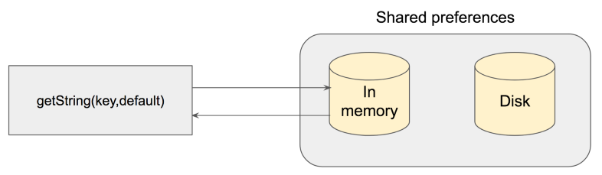
Get data
All get operations are done through in-memory storage, which is immediate and IO operation is avoided. Because all operations go through memory first, it is guaranteed to return the last value.
String value = pref.getString(key, default_value)
Get preference method require a string to return in case of error in reading

Slide 11
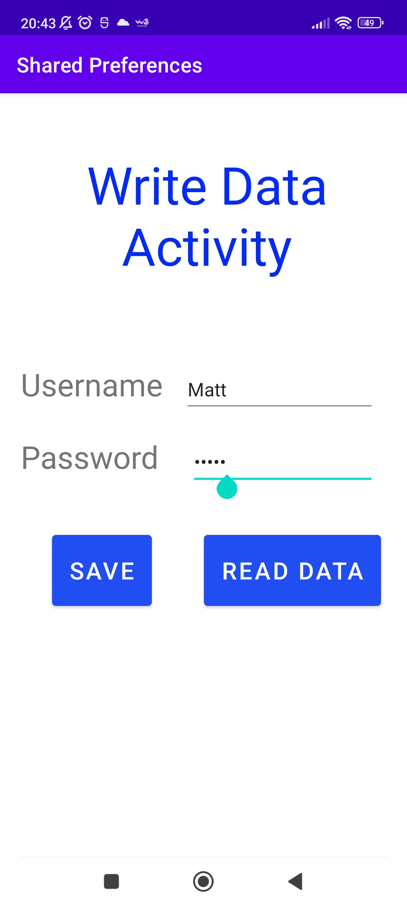
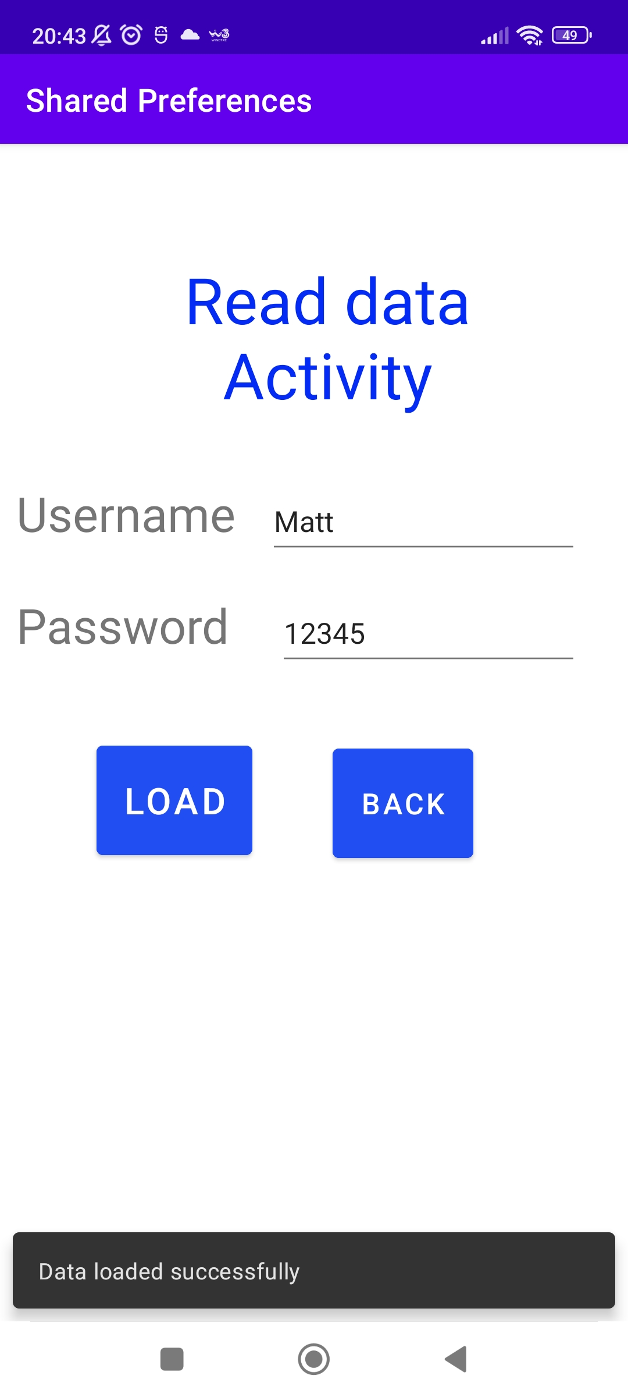
Example
Suppose to have an application with two activities: one that allows the storage of user credentials and one that allows you to view them

Slide 12
Implementation
public class ActivityB extends AppCompatActivity { public final static String DEFAULT="N/A"; Button load; EditText username,password; @Override protected void onCreate(Bundle savedInstanceState) { super.onCreate(savedInstanceState); setContentView(R.layout.activity_b); username=findViewById(R.id.username_edit); password=findViewById(R.id.pass_edit); load=findViewById(R.id.load_button); load.setOnClickListener(new View.OnClickListener() { @Override public void onClick(View v) {
SharedPreferences sharedPreferences=getSharedPreferences("MyData", MODE_PRIVATE); String name=sharedPreferences.getString("username",DEFAULT); String pass=sharedPreferences.getString("password",DEFAULT); if(name.equals(DEFAULT) || pass.equals(DEFAULT)) { Snackbar.make(relativeLayout,"No data was found",Snackbar.LENGTH_SHORT).show(); } else { Snackbar.make(relativeLayout,"Data loaded successfully",Snackbar.LENGTH_SHORT).show(); username.setText(name); password.setText(pass); } } }); } }
public class ActivityA extends AppCompatActivity { @Override protected void onCreate(Bundle savedInstanceState) { super.onCreate(savedInstanceState); setContentView(R.layout.activity_a); username=findViewById(R.id.username_edit); password=findViewById(R.id.pass_edit); savebtn=findViewById(R.id.save_button); relativeLayout=findViewById(R.id.relative_layoutA); savebtn.setOnClickListener(new View.OnClickListener() { @Override public void onClick(View v) { sharedPreferences= getSharedPreferences("MyData", MODE_PRIVATE); SharedPreferences.Editor editor = sharedPreferences.edit(); editor.putString("username", username.getText().toString()); editor.putString("password", password.getText().toString()); editor.commit(); } }); } }

Slide 13
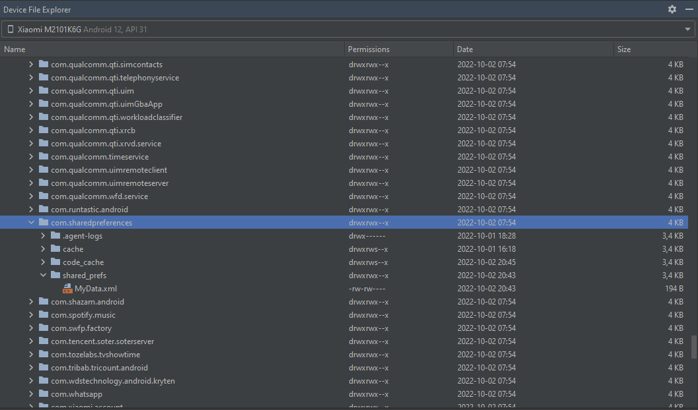
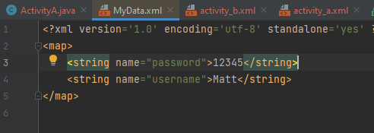
At runtime
When your App is running on the emulator/ physical device, go on device manager Android studio window, select device file explorer action (icon folder button), browse data/data/com.package_name/shared_preferences. Inside is created a file and if we open it we can find data saved.

Slide 14
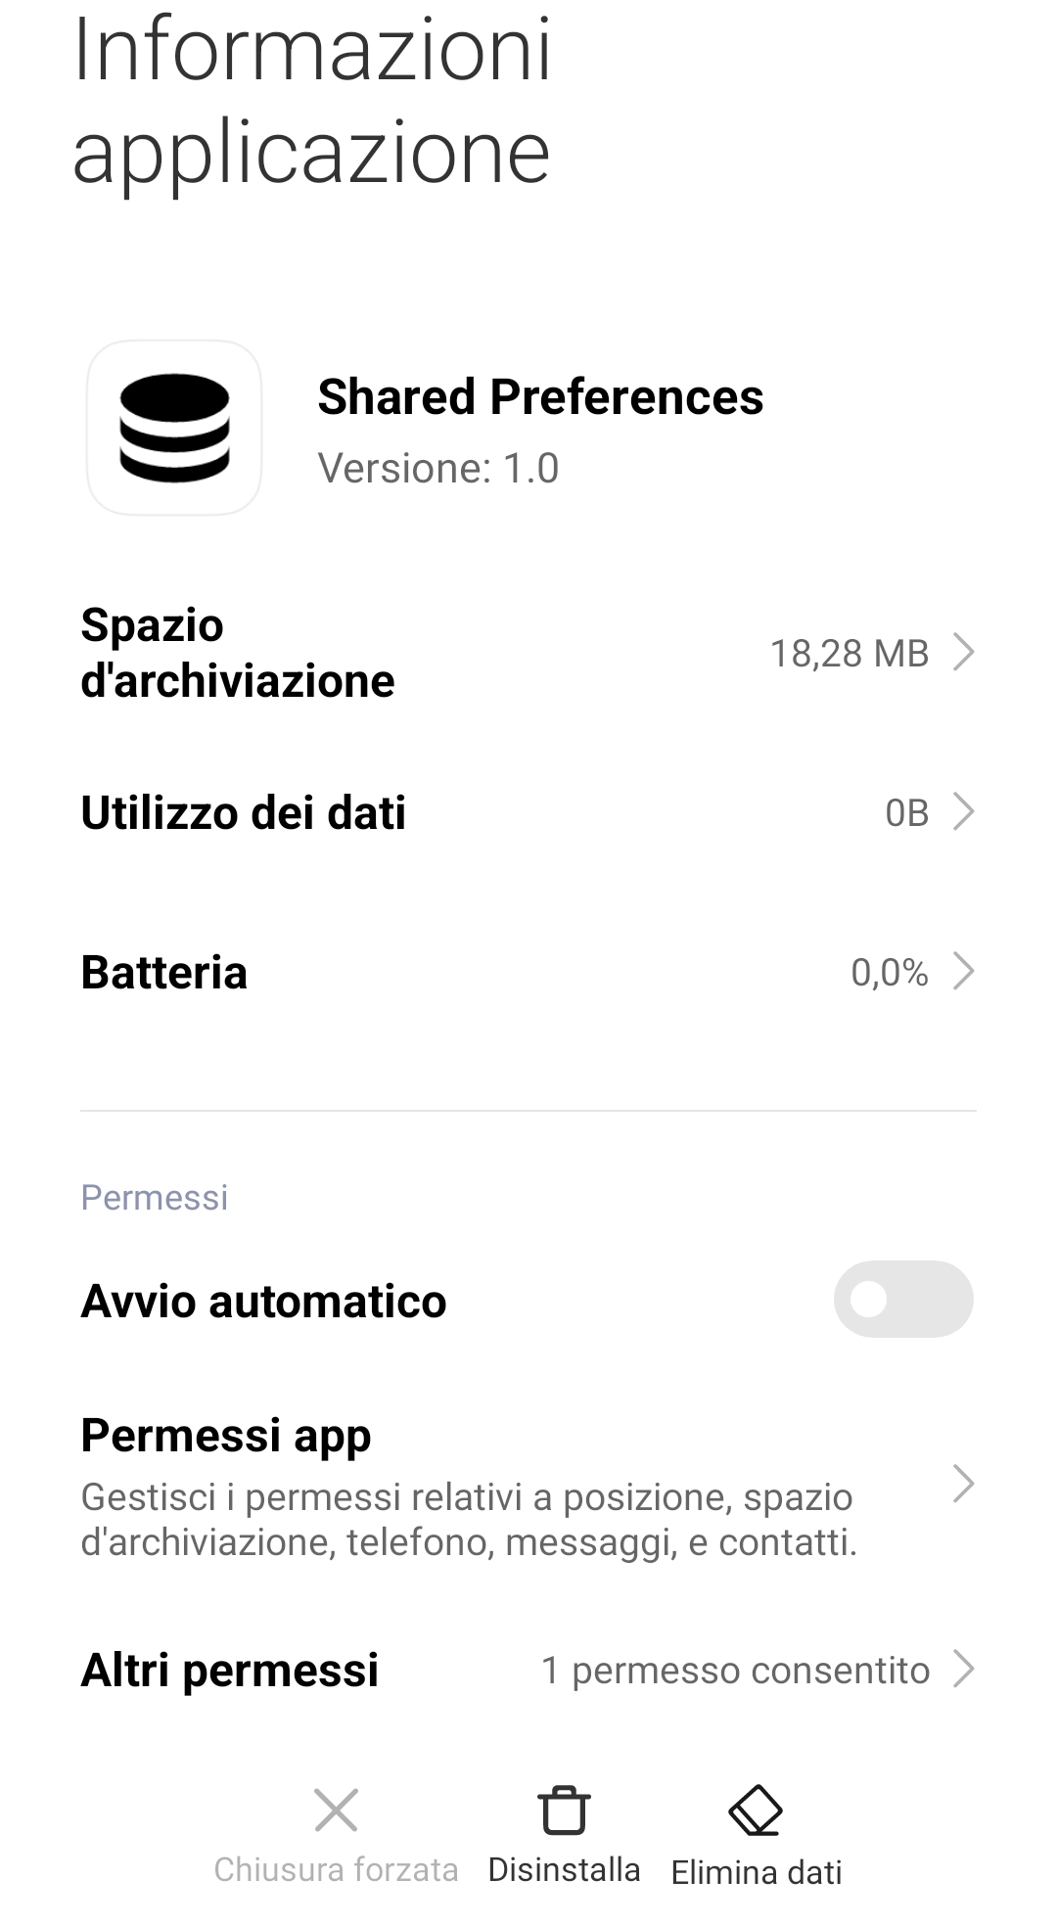
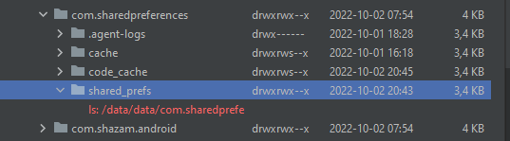
What happens if?
One of the reasons why although extremely simple saving data , but strongly discouraged the use of SharedPreferences is due to the fact that users with a simple action of erasing data through the application section of their smartphones can erase all the data contained in the file. at last, if we uninstall the application all the data contained in it will be lost and no longer recoverable.

Slide 15
Pros and cons
SharedPreferences are a simple way to access fast to data loaded in memory, allow us to share data between two applications.
SharedPreferences are used to store small bits of data related to user configuration, we can’t store any multimedia files.
It can only store basic data types, so if you have more complex bits of information, we should probably switch to another mechanism.
unfortunately, do not represent an optimal solution, since the information read may be incorrect and there is no way to keep the data history

Slide 16
Cache Storage
File stored in the files folder are persistent and remain until are deleted sometimes is necessary to store data temporarily. To get a cache internal or external reference with:
getCacheDir()
getExternalCacheDir()
return a cache reference specifying absolute path for cache directory. Use the File class to create a file inside that cache folder, those are stored in data/data/<package name>/cache folder.
Cache
App
……

Slide 17
Store and Retrieve data
Get a reference to cache directory
Get a reference to file
Read/Write operation
Save data
File cacheDir=getCacheDir();
File file=new File( cacheDir.getAbsolutePath(), “text.txt”); //if file doesn’t exist will be created
FileOutputStream fOut = new FileOutputStream(file);
Retrieve data
File cacheDir=getCacheDir();
File file=new File( cacheDir.getAbsolutePath(), “text.txt”);
FileInputStream fIn= new FileInputStream(file);
Open a file and read or write throws exception, we must add try/catch block and handle the exception.
Note When a device is low on internal storage space, android may delete these cache files to recover space.
Do not rely on the system to clean up these files.
Always maintain the cache files in our app, the best practice is to stay within a limit such as 1MB.
When user uninstall app, these files are removed. Cache directory is partly about storing data in internal and external storage.

Slide 18

Internal Storage
Internal storage allow us to read and write files that associated with each application’s internal memory. These files can only be accessed by the application and not from other applications or users.
when the app is uninstalled, these files are automatically removed as well
Our date are saved in internal storage directory is specified by our app’s package name in a specific location of the Android file system. data/data/<package-name>/files
Other apps and users can’t browse our internal directories and read or write our file, unless we explicitly set those to be readable or writable.
Internal Storage is the best solution when we want to make sure that neither user or other apps can access files

Slide 19

InputFileStream & OutputFileStream
As we saw on java-oriented object part of this course, to read and write data we use method from Stream Java Class:
openFileOutput(String filename, int Mode)
openFileInput(String filename, int Mode)
Type of mode:
MODE_PRIVATE: only our app can access the file
MODE_WORD_READABLE: All apps can read the file (deprecated)
MODE_WORD_WRITABLE: All apps can write on the file (deprecated)
MODE_MULTI_PROCESS: Multiple processes can modify the same shared preference file.

Slide 20
Read Example
FileInputStream input=openFileInput(“mytext.txt”,Context.MODE_PRIVATE); //If file doesn’t exist, it will return and IOException StringBuffer buffer=new StringBuffer(); int c; while((c=input.read())!=-1){ buffer.append(((char) c)); }
As we use a Stream, we will read binary data and it is our task to convert the data in the right format.
File System
App
openFileInput(“mytext.txt”,Context.MODE_PRIVATE)
0101010101010101

Slide 21
Write Example
FileOutputStream out= openFileOutput(“mytext.txt”,Context.MODE_PRIVATE);
//If file doesn’t exist, it will create and empty file // byte[] buff=string.getBytes(); out.write(buff); out.close();
Exclusive use of the FileInputStream may require very long and complicated controls and operations, we recommend using specialized superclasses ex: BufferedReader
File System
App
openFileOutput(“mytext.txt”,Context.MODE_PRIVATE)
0101010101010101

Slide 22


External Storage
External memory such as internal allows you to save data and files needed for our application. External memory allows you to save two types of files:
Private files: files rightfully belong to our app and should be deleted together when the user uninstalls the app.
They don’t provide value to user outside our app.
ex: settings of our application.
Public files: files that should be freely available to other apps and users. ex: photo, videos.
Files are not deleted when the user uninstalls the app.
Notes:
To access to private files use getExternalFilesDir() to store private files on External Storage (to get a reference to file that points to private files folder on our external storage).
remember: files are deleted when the user uninstalls the app. To access them use getExternalStoragePublicDirectory() to store public files on external storage (to get a reference to file that points to private files folder on our external storage).

Slide 23
Read & Write External Storage
Read/Write operation require permission, we must add it into Manifest.xml
WRITE_EXTERNAL_STORAGE
READ_EXTERNAL_STORAGE
Check if external storage is available mounted using getExternalStorageState() method. Tells all information such as: is mounted, readable, writable
Get a reference to external storage
Use FileInputStream and FileOutputStream to do required operation.
Notes:
getExternalStorageFilesDir(String type): create files specific to our app that are removed when our app is uninstalled. storing private files into External Storage
getExternalStoragePublicDirectory(String type) :store files not should be kept public even when our app in uninstalled recommended to store public files on external storage (deprecated)
getExternalStorageDirectory(): get root of external storage older version to access external storage API 7
*getExternalCacheDir(): store cache files on external that are removed when the app is uninstalled and not accessible when SD card is removed

Slide 24
getExternalStorageDirectory()
Returns primary external storage directory gives a reference that points to the primary folder SDcard. Older version, now we have two separate methods. This directory can not access directly if our mobile is not connected to computer or if is not mounted an SDCard or something else goes wrong. Before transfer data we must called getExternalStorageState(File) then read or write data.
Constants
MEDIA_BAD_REMOVAL: storage state if the media was removed before it was unmounted.
MEDIA_CHECKING: storage state if the media is present and being disk-checked.
MEDIA_EJECTING: storage state if the media is in the process of being ejected.
MEDIA_MOUNTED: storage state if the media is present and mounted at its mount point with read/write access.
MEDIA_MOUNTED_READ_ONLY: storage state if the media is present and mounted at its mount point with read-only access.
MEDIA_REMOVED: storage state if the media is not present.
Note
if our device has multiple users, each of them has his own isolated external storage which means if there are a guest mode, and we are hosting our data is not visible to hosts for a security reason
if there are multiple external storage directories, this directory represent the primary external storage that user will interact with.
don’t use the top-level directory directly in order to keep organized files (avoid placing files outside of directories to avoid problems recognizing the file belonging to an app)

Slide 25
Methods
getExternalStorageDirectory()
getExternalStorageFilesDir(String type)
Is used to store private files into External Storage.
Create files specific to our app that are removed when our app is uninstalled.
Private files must place with this method, after the app is uninstalled, the system will take care of deleting those files.
File path=getExternalFilesDir(“MyApp”);
It will create a folder named like the given parameter instead return null. Directories returned belong to the application (are private), they will be destroyed after the app has been uninstalled
getExternalStoragePublicDirectory(String type)
Get a top-level shared/external storage directory for placing files of a particular type.
Where user will typically place and manage their own files, so we should be careful about what we put here to ensure they don't erase their or our files.
On devices with multiple users, each user has their own isolated external storage
Applications only have access to the external storage for the currently active user.
Currently the method has been deprecated you can use it through the Environment class

Slide 26
Evironment.getExternalStoragePublicDirectory(String type)
Fields
DIRECTORY_MUSIC
DIRECTORY_PODCASTS
DIRECTORY_RINGTONES
DIRECTORY_NOTIFICATIONS
DIRECTORY_ALLARMS
DIRECTORY_DOWNLOADS
DIRECTORY_PICTURES
DIRECTORY_MOVIES
Each parameter gives a reference that point to a specific directory inside external storage. If type is not null, the returned file will be a path to a
sub-directory of the given type.

Slide 27
Internal Vs External storage
Internal Storage | External Storage
Less memory available [many MBs, few GBs] | More memory available
Speed Access: same | Speed Access: same
More secure: Only our app can access internal storage data and it's deleted when app is uninstalled | Less secure: anyone can read the external files and not destroyed after the app was uninstalled.
Data are available inside our Device as long as our app is installed. | Data are available as long as SD card is mounted inside the device, be aware of depending mostly by SD memory.

Slide 28
Internal Vs Shared Preferences
Shared Preferences | Internal Storage
Allow to storing data into XML files as key-pair values. | Allow Storing data and files into external secure digital card or primary memory.
More efficient due to less read/write overhead involved | Less efficient: more read/write operation are involved
Can store only primitive types and at most arrays of strings | Store complex data: files, media, images ….

Slide 29


Slide 30
SQLite
After seeing various tools for storing data, it is inevitable to think that in an application you have to deal with a database.
SQLite is a lightweight transactional database engine that takes up little space in memory and disk (from about 4KB to about 350KB, depending on the target platform).Therefore, it is the perfect technology to create and manage databases in an environment such as mobile applications, where resources are very limited and therefore it is very important to optimize their use.
SQLite is a scaled-down version of MySQL, PostgreSQL and other popular database systems.
Each application has its own SQLite database accessible by any class in the app but not by others.
Is transactionally in nature which means if something goes wrong things are rolled back
Now we can create a database using third-part tools that we already know.
A SQLite database is created and stored always in /data/data/<package name>/databases folder.

Slide 31
Issue
Reference to our complex and potentially dangerous database if not properly secured. ex: a class uses a method that deletes all tables in the db. Multiple instantiation of the same object can create unpleasant situations. The solution is to introduce a layer of abstraction to make interactions with our database safer and easier, an abstraction that provides intuitive, flexible and robust methods for entering, deleting and editing database records.
App
?
SQLite
Java
SQL
Java
SQL

Slide 32
Introducing Pattern Adapter
An adapter wraps one of the objects to hide the complexity of conversion happening behind the scenes. The wrapped object isn’t even aware of the adapter. For example, you can wrap an object that operates in meters and kilometers with an adapter that converts all the data to imperial units such as feet and miles.
Adapters can not only convert data into various formats but can also help objects with different interfaces collaborate. Here’s how it works:
The adapter gets an interface, compatible with one of the existing objects.
Using this interface, the existing object can safely call the adapter’s methods.
Upon receiving a call, the adapter passes the request to the second object, but in a format and order that the second object expects.
Adapter
App
Java
SQLite
Java
SQL
Java
SQL
SQL

Slide 33
3 Level Design
In our case the pattern can be implemented with three-level structure:
SqliteOpenHelper. An abstract class used to better implement the pattern for creating, updating and managing databases. By implementing a SQLiteOpenHelper helper we are hiding the logic used to decide if the database needs to be created or updated before being opened:
This is the first level of abstraction that provides us with more flexibility and maintainability. Is responsible for managing the creation and changes of database.
SQLiteOpenHelper
onCreate()
onUpgrade()
App
Adapter
InsertCall()
Insert()
SQLiteOpenHelper
(Concrete Implementation)
getWritableDatabase()
UpdateCall()
Update()
DeleteCall()
Delete()
QueryCall()
Query()
SQLiteDatabase
SQLiteDatabase

Slide 34
3 Level Design
By implementing SqLiteOpenHelper interface, we can get a reference to our Database with the getWritableDatabase(). It will return database object in read/write in active mode until it is closed. If is the first-time the database is open onCreate(), onUpgrade() will called.
SQLiteOpenHelper
onCreate()
onUpgrade()
App
Adapter
InsertCall()
Insert()
SQLiteOpenHelper
(Concrete Implementation)
getWritableDatabase()
UpdateCall()
Update()
DeleteCall()
Delete()
QueryCall()
Query()
SQLiteDatabase
SQLiteDatabase

Slide 35
3 Level Design
SQLiteOpenHelper
onCreate()
onUpgrade()
As already said the adapter masks the complexity of the operations with the Database making it safe to work with.
The adapter class is where the methods to enter, update, delete or query the database will be implemented. Need to refer to the SQLite OpenHelper object using the method described previously.
For security reasons it is advisable to put your own implementation of the SQLiteOpenHelper directly inside the Adapter as inner-class.
App
Adapter
InsertCall()
Insert()
SQLiteOpenHelper
(Concrete Implementation)
getWritableDatabase()
UpdateCall()
Update()
DeleteCall()
Delete()
QueryCall()
Query()
SQLiteDatabase
SQLiteDatabase

Slide 36
3 Level Design
Call methods invoke in response to UI requests (changing) ex: User clicks add button.
The corresponding call is invoked and put the data using adapter’s insert method, those will tell if data are insert correctly and returning something back.
SQLiteOpenHelper
onCreate()
onUpgrade()
App
Adapter
InsertCall()
Insert()
SQLiteOpenHelper
(Concrete Implementation)
getWritableDatabase()
UpdateCall()
Update()
DeleteCall()
Delete()
QueryCall()
Query()
SQLiteDatabase
SQLiteDatabase

Slide 37
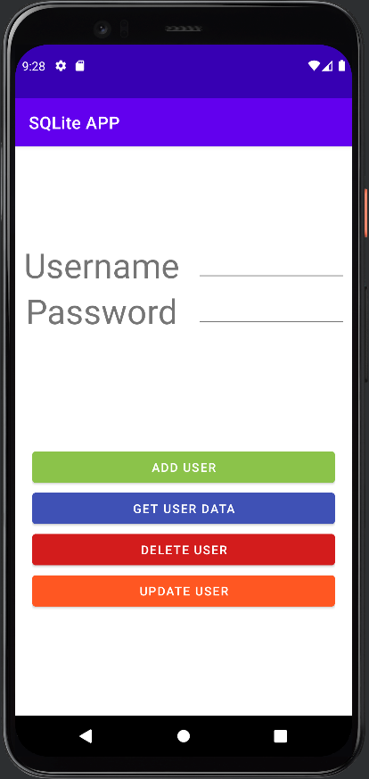
Example
Let’s try to explain the various operations of a Database with a simple application.
In particular one that allows us to:
Add Record
Get Data
Delete Record
Update Record

Slide 38
Create Database
Create a SQLiteOpenHelper implementation
Define inside static values, which represent Database name, Table, column name.
private static final String DATABASE_NAME=”mydatabase.db” or “mydatabase”;
public static final String TABLE_NAME=”Table1”;
public static final String String UID=”id”;
public static final String String NAME=”name”;
public static final String int DATABASE_VERSION=1;
Implement onCreate() ,onUpgrade() methods
Note
Use ALTER_TABLE To transfer data inside the onUpgrade method from old to new one and add existing null values or something for newly created columns that we have provided they support nullable value.

Slide 39
Implementation
class SQLiteHelper extends SQLiteOpenHelper { private static final String DATABASE_NAME ="MyDataBase.db"; private static final int DATABASE_VERSION = 1; public static final String PASSWORD = "Password"; public static final String NAME ="Name"; public static final String UID="_id"; public static final String TABLE_NAME ="USERS"; private static final String createTable="CREATE TABLE "+TABLE_NAME+"("+UID+" INTEGER PRIMARY KEY AUTOINCREMENT,"+NAME+" VARCHAR(255), "+PASSWORD+" VARCHAR(255), UNIQUE("+NAME+"));";
private static final String dropTable="DROP TABLE IF EXISTS "+TABLE_NAME+";"; private Context context;
public SQLiteHelper(Context context) { super(context, DATABASE_NAME, null, DATABASE_VERSION); this.context=context; Toast.makeText(context,"constructor called",Toast.LENGTH_SHORT).show(); } }
@Override public void onCreate(SQLiteDatabase db) { try{ db.execSQL(createTable); } catch (SQLException e) { e.printStackTrace(); } } @Override public void onUpgrade(SQLiteDatabase db, int oldVersion, int newVersion) { db.execSQL("DROP TABLE if exists table1;"); try { db.execSQL(dropTable); onCreate(db); } catch (SQLException e) { e.printStackTrace(); } }
Avoid RAW queries like executeQuery("select * FROM table;"); because they are dangerous because we can run any query that has a valid SQL syntax. Actually. IDE has high SQL syntax control.

Slide 40
Insert Data
Get a reference to database
Use ContentValues to store data
Insert record inside database with insert() method
Return result of the operation.
public class DataBaseAdapter { private SQLiteHelper sqLiteHelper; private Context context; public DataBaseAdapter(Context context) { this.sqLiteHelper = new SQLiteHelper(context); this.context=context; }
public long insertData(String username, String pass) { ContentValues contentValues=new ContentValues(); SQLiteDatabase db=sqLiteHelper.getWritableDatabase(); contentValues.put(SQLiteHelper.NAME,name); contentValues.put(SQLiteHelper.PASSWORD,password); long id=db.insert(sqLiteHelper.TABLE_NAME,null,contentValues); return id; }
}
By initializing SQLiteHelper we have not yet accessed the database, to access a database object that represents the physical database file stored on our device, we must call the getWriteableDatabase() method and that ‘ll trigger the other lifecycle methods of SQLiteOpenHelper.
ContentValues Java Class that maps data structure, takes as parameters a Key and a Value. For every column specify the name of the column as KEY.

Slide 41
Insert Data
Insert(String table, String nullColumnHack, ContentValues contentValues)
nullColumnHack is optional and may be null. SQL doesn't allow inserting a completely empty row without naming at least one column name. If provide empty values, no column names are known, and an empty row can't be inserted. If not set to null, the nullColumnHack parameter provides the name of the nullable column name to explicitly insert a NULL into in the case where your values is empty.
Ex:
db.insert(SQLiteHelper.TABLE_NAME,null,contentValues);
this wouldn’t work, but if specify name of any 1 column inside table can be NULL, we can have other column but is needed to be specified.
db.insert(SQLiteHelper.TABLE_NAME,SQLiteHelper.COLUMN_NAME,contentValues);
in this way we can insert a null row.
If insert operation is successful it will return ID inserted row or -1 if the operation fails. public long insert.
Note
Every time we modify database schemas, we must change database versions to avoid runtime exceptions.
public class DataBaseAdapter { private SQLiteHelper sqLiteHelper; private Context context; public DataBaseAdapter(Context context) { this.sqLiteHelper = new SQLiteHelper(context); this.context=context; }
public long insertData(String username, String pass) { ContentValues contentValues=new ContentValues(); SQLiteDatabase db=sqLiteHelper.getWritableDatabase(); contentValues.put(SQLiteHelper.NAME,name); contentValues.put(SQLiteHelper.PASSWORD,password); long id=db.insert(sqLiteHelper.TABLE_NAME,null,contentValues); return id; }
}

Slide 42
Get Data
Create an object reference to SQLiteOpenHelper
SQLiteOpenHelper sqLiteHelper = new SQLiteHelper(context);
Get a reference to db:
SQLiteDatabase db=sqLiteHelper.getWritableDatabase();
Perform a rawQuery and store the data return
String query=”SELECT * FROM TABLENAME”;
Cursor cursor = db.query(SQLiteHelper.TABLE_NAME, columns, null, null, null, null, null);
query(String table, String[ ] columns, String selection, String[ ] selectionArgs, String groupBy, String having, String orderBy);
String table: Table name to compile the query
String[] columns: A list of which columns to return. Passing null will return all columns, which is discouraged to prevent reading data from storage that isn't going to be used.
String selection: A filter declaring which rows to return, formatted as an SQL WHERE clause (excluding the WHERE itself). Passing null will return all rows for the given table.
String[] selectionArgs: inside query we may include “?” in selection, which will be replaced by the values from selectionArgs at run time, in order that they appear in the selection.

Slide 43
Get Data
Create an object reference to SQLiteOpenHelper
SQLiteOpenHelper sqLiteHelper = new SQLiteHelper(context);
Get a reference to db:
SQLiteDatabase db=sqLiteHelper.getWritableDatabase();
Perform a rawQuery and store the data return
String query=”SELECT * FROM TABLENAME”;
Cursor cursor = db.query(SQLiteHelper.TABLE_NAME, columns, null, null, null, null, null);
query(String table, String[ ] columns, String selection, String[ ] selectionArgs, String groupBy, String having, String orderBy);
String groupBy: A filter declaring how to group rows, formatted as an SQL GROUP BY clause (excluding the GROUP BY itself). Passing null will cause the rows to not be grouped.
String having: A filter declare which row groups to include in the cursor, if row grouping is being used, formatted as an SQL HAVING clause (excluding the HAVING itself). Passing null will cause all row groups to be included and is required when row grouping is not being used.
String orderBy: How to order the rows, formatted as an SQL ORDER BY clause (excluding the ORDER BY itself). Passing null will use the default sort order, which may be unordered.

Slide 44

Cursor Object
API which allow us to navigate from top to bottom of result set (result obtained).
Provides random read-write access to the result set returned by a database query.
Cursor implementations are not required to be synchronized. So, code using a Cursor from multiple threads should perform its own synchronization. Be Careful when we use multiple threads.
If the database is empty, the returned object is null, if data is present, a cursor pointing to the column name is returned. We can scroll the cursor with the following methods:
String getColumnName(int columnIndex)
String getColumnIndex(String columnName)
int getCount(): returns the number of rows in the cursor.
getString (int columnIndex): returns the value of that column as an int.
getInt(int columnIndex): returns the value of that column as a String.
getType(int columnIndex): returns column value type
boolean moveToNext(): whether the move succeeded
Cursor

Slide 45
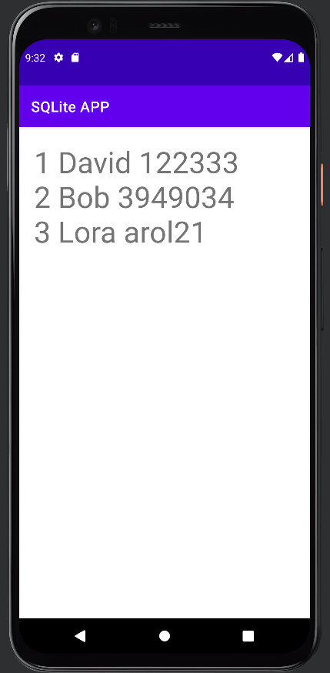
Implementation
public String getData(String name){ SQLiteDatabase db=sqLiteHelper.getWritableDatabase(); String columns[]={sqLiteHelper.NAME,sqLiteHelper.PASSWORD}; /**1st way**/ String whereCondition=columns[0]+"=\""+name+"\""; Cursor cursor=db.query(sqLiteHelper.TABLE_NAME,columns,whereCondition,null,null,null,null); /***2nd way**/ String selectionArgs[]={name}; String whereCondition=columns[0]+"=?"; Cursor cursor=db.query(sqLiteHelper.TABLE_NAME,columns,whereCondition,selectionArgs,null,null,null); StringBuffer stringBuffer=new StringBuffer(); int index; if(cursor!=null) { while (cursor.moveToNext()) { for (int i = 0; i < columns.length; ++i) { index = cursor.getColumnIndex(columns[i]); stringBuffer.append(cursor.getString(index) + " "); } stringBuffer.append("\n"); } } else { Toast.makeText(context,"empty Database",Toast.LENGTH_SHORT).show(); } return stringBuffer.toString(); }

Slide 46
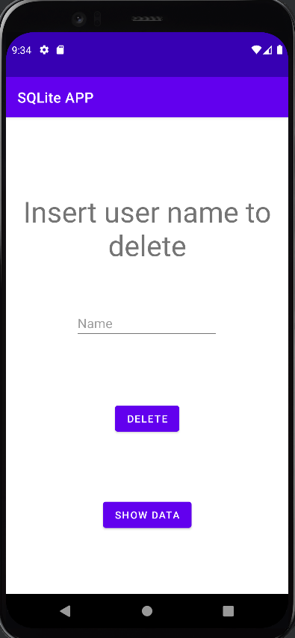
Delete Data
DatabaseAdapter
public int deleteData(String name) { SQLiteDatabase db=sqLiteHelper.getWritableDatabase(); String[] whereArgs={name}; String deleteQuery=SQLiteHelper.NAME+"=?"; int num=db.delete(SQLiteHelper.TABLE_NAME,deleteQuery,whereArgs); return num; }
Add, delete, update method returns row number effected by changes
public ArrayList<String> getUsersName() {
String columns[]={sqLiteHelper.NAME}; SQLiteDatabase db=sqLiteHelper.getReadableDatabase(); Cursor cursor=db.query(sqLiteHelper.TABLE_NAME,columns,null,null,null,null,null); StringBuffer stringBuffer=new StringBuffer(); ArrayList<String> users=new ArrayList<>(); int index= cursor.getColumnIndex(sqLiteHelper.NAME); while (cursor.moveToNext()) { users.add(cursor.getString(index)); } return users; }

Slide 47
Delete Data
DeleteActivity
private void delete() { sqlitehelper.getUsersName(); String deleteUsr=deleteUsername.getText().toString(); if(deleteUsr.length()!=0) { ArrayList<String> users=sqlitehelper.getUsersName(); if(users.contains(deleteUsr)) { sqlitehelper.deleteData(deleteUsername.getText().toString()); Toast.makeText(this,deleteUsr+" deleted",Toast.LENGTH_SHORT).show(); } else { Toast.makeText(this,deleteUsr+" not in database",Toast.LENGTH_SHORT).show(); } } }

Slide 48
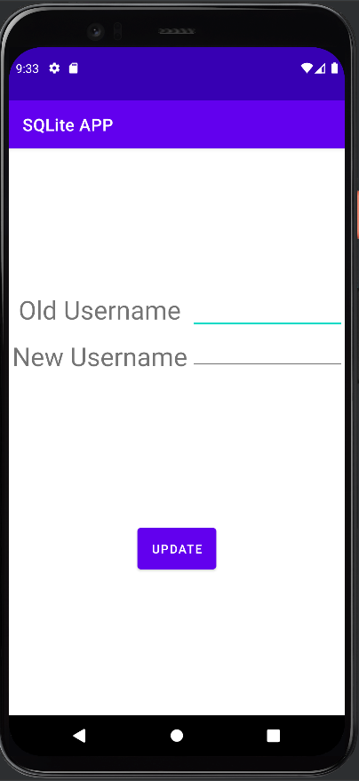
Update Data
DatabaseAdapter
public int updateData(String oldName,String newName) { SQLiteDatabase db=sqLiteHelper.getWritableDatabase(); String queryUpdate= SQLiteHelper.NAME+"=?"; ContentValues contentValues=new ContentValues(); contentValues.put(sqLiteHelper.NAME,newName); String whereArgs[]={oldName}; int rowNum=db.update(SQLiteHelper.TABLE_NAME,contentValues,queryUpdate,whereArgs); return rowNum; }
UpdateActivity
private void updateRecord() { ArrayList<String> users=sqlitehelper.getUsersName(); if(users.contains(oldUsername.getText().toString())) { sqlitehelper.updateData(oldUsername.getText().toString(),newUsername.getText().toString()); Toast.makeText(this,"updated",Toast.LENGTH_SHORT).show(); finish(); } else { Toast.makeText(this,oldUsername.getText().toString()+" not in database",Toast.LENGTH_SHORT).show(); } }

Slide 49


Slide 50
What is Firebase?
Firebase is a serverless platform for mobile and web application development.
Open source but supported by Google, Firebase leverages Google’s infrastructure and cloud to provide a suite of tools to write, analyze and maintain cross-platform applications. Firebase offers features such as analysis, database (using nosql structures), messaging and crash reporting for managing web, iOS and Android applications

Slide 51
Why we need an empty constructor?
The fields of the class will be filled in using reflection. But you cannot create a "default" object (meaning: with no fields pre-filled) without a constructor. Firebase cannot figure out on its own what your constructor does, so that's why you need an empty constructor: to allow Firebase to create a new instance of the object, which it then proceeds to fill in using reflection.
This is not specific to Firebase: you'll find the empty constructor everywhere where a framework or library fills in an object for you, such as JPA/Hibernate.
Edit: for completeness' sake, as @Lutzi mentioned, once you define your own constructor, the default empty constructor that Java defines is no longer available to you, which is why you need to define it explicitly.

